Slide 1
Measurement Of Central Tendency
Dr. Mirza Mohd Abu Tayyab
Department of Sociology
Shia PG College, Lucknow

Slide 2
Importance Of Central Tendency
To find representative value
To make more concise data
To make comparisons
Helpful in further statistical analysis

Slide 3
Introduction:
In statistics, a central tendency is a central value or a typical value for a probability distribution.
It is occasionally called an average or just the center of the distribution.
The most common measures of central tendency are the arithmetic mean, the median and the mode.
Measures of central tendency are defined for a population(large set of objects of a similar nature) and for a sample (portion of the elements of a population).

Slide 4
Mean
The MEAN of a set of values or measurements is the sum of all the measurements divided by the number of measurements in the set.
The mean is the most popular and widely used. It is sometimes called the arithmetic mean.

Slide 5
Mean for Ungrouped data
If we get the mean of the sample, we call it the sample mean and it is denoted by (read “x bar”).
If we compute the mean of the population, we call it the parametric or population mean, denoted by μ (read “mu”).

Slide 6
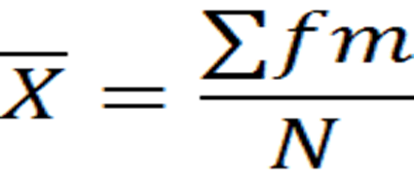
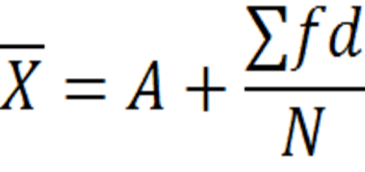
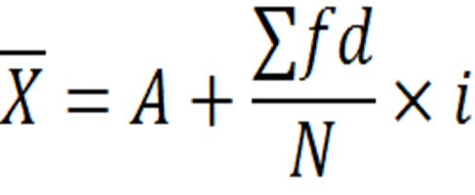
Arithmetic Mean Calculated Methods for grouped data:
Direct Method :
Short cut method :
Step deviation Method :

Slide 7
Example Of A.M:
A sample of five executives received the following bonus last year ($000):
14.0, 15.0, 17.0, 16.0, 15.0
Solution:

Slide 8
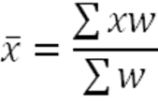
Weighted Mean
Weighted mean is the mean of a set of values wherein each value or measurement has a different weight or degree of importance. The following is its formula:
where = mean
x = measurement or value
w = number of measurements

Slide 9
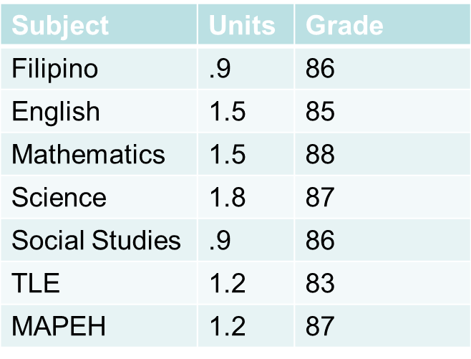
Example Of W.M

Slide 10
Harmonic Mean
Harmonic mean is quotient of “number of the given values” and “sum of the reciprocals of the given values”.
For Ungrouped Data
For grouped Data

Slide 11
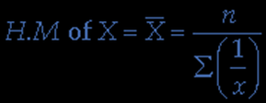
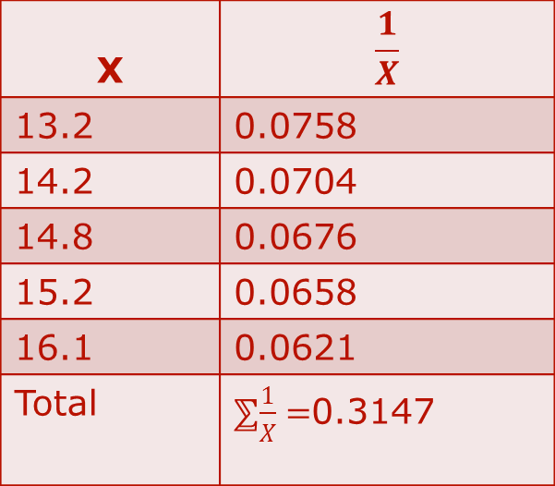
Harmonic Mean Example
Calculate the harmonic mean of the numbers: 13.2, 14.2, 14.8, 15.2 and 16.1
Solution:
The harmonic mean is calculated as below:
AS
X | $$\frac{1}{X}$$
13.2 | 0.0758
14.2 | 0.0704
14.8 | 0.0676
15.2 | 0.0658
16.1 | 0.0621
Total | ⅀$\frac{1}{X}=$0.3147

Slide 12
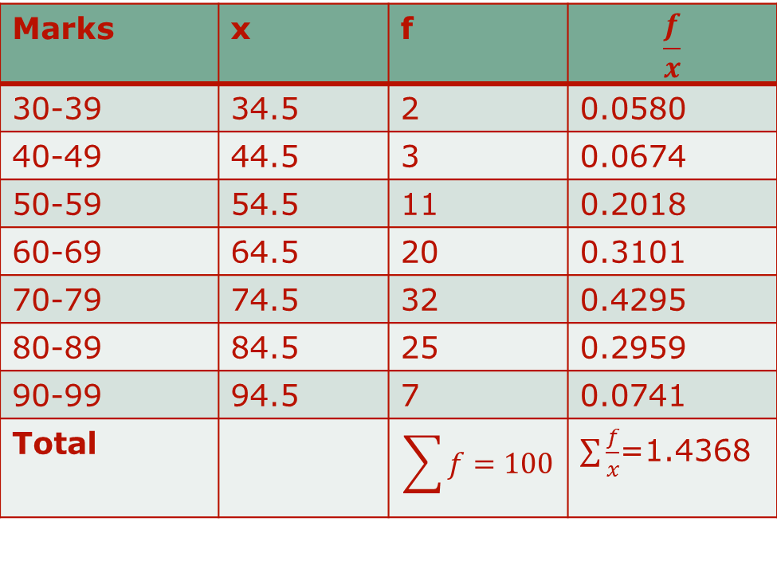
Example: Calculate the harmonic mean for the given below:
Marks | 30-39 | 40-49 | 50-59 | 60-69 | 70-79 | 80-89 | 90-99
F | 2 | 3 | 11 | 20 | 32 | 25 | 7
Solution: Now We’ll find H.M as:
Marks | x | f
30-39 | 34.5 | 2 | 0.0580
40-49 | 44.5 | 3 | 0.0674
50-59 | 54.5 | 11 | 0.2018
60-69 | 64.5 | 20 | 0.3101
70-79 | 74.5 | 32 | 0.4295
80-89 | 84.5 | 25 | 0.2959
90-99 | 94.5 | 7 | 0.0741
Total

Slide 13
Geometric Mean
Geometric mean is a kind of average of a set of numbers that is different from the arithmetic average.
The geometric mean is well defined only for sets of positive real numbers. This is calculated by multiplying all the numbers (call the number of numbers n), and taking the nth root of the total.
A common example of where the geometric mean is the correct choice is when averaging growth rates.
The geometric mean is NOT the arithmetic mean and it is NOT a simple average.
Mathematical definition: The nth root of the product of n numbers.

Slide 14
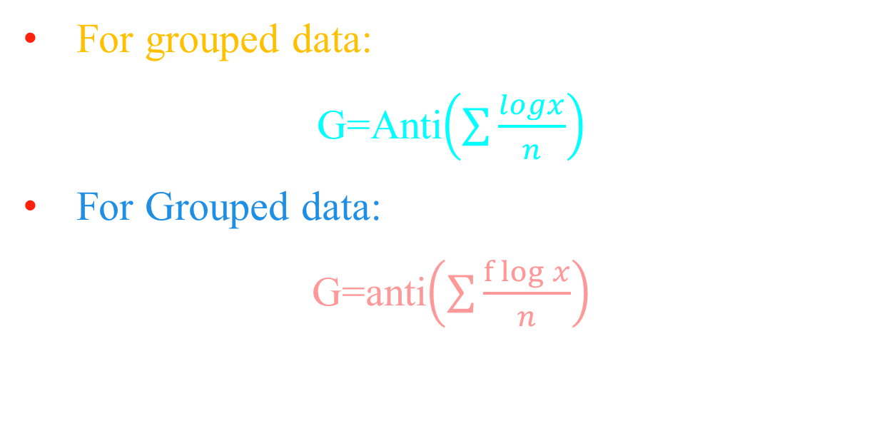
Formulas

Slide 15
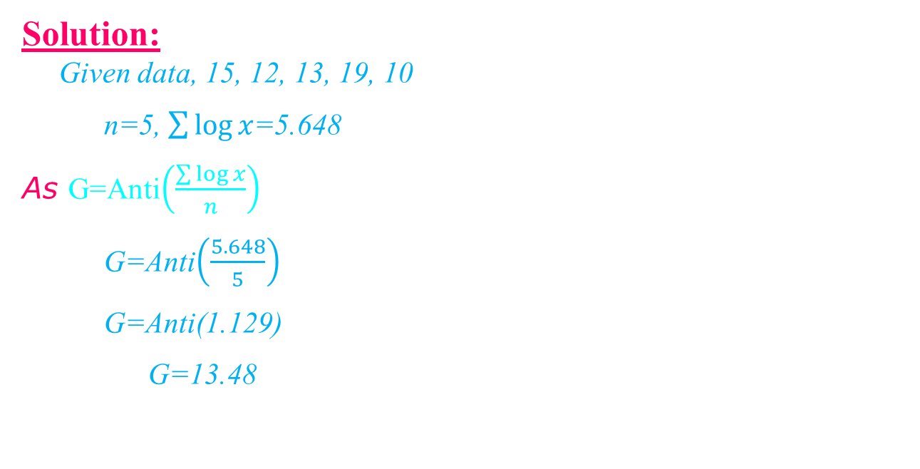
Question 1: Find the geometric mean of the following values: 15, 12, 13, 19, 10
x | Log x
15 | 1.1761
12 | 1.0792
13 | 1.1139
19 | 1.2788
10 | 1.0000
Total | 5.648

Slide 16
MEDIAN

Slide 17
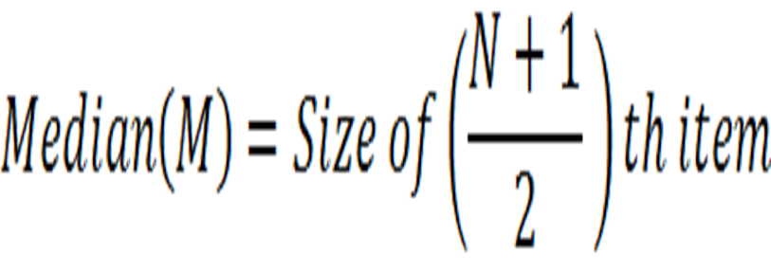
Median
The MEDIAN, denoted M, is the middle value of the sample when the data are ranked in order according to size.
Connor has defined as “ The median is that value of the variable which divides the group into two equal parts, one part comprising of all values greater, and the other, all values less than median”
For Ungrouped data median is calculated as:
For Grouped Data:

Slide 18
Example OF Median

Slide 19
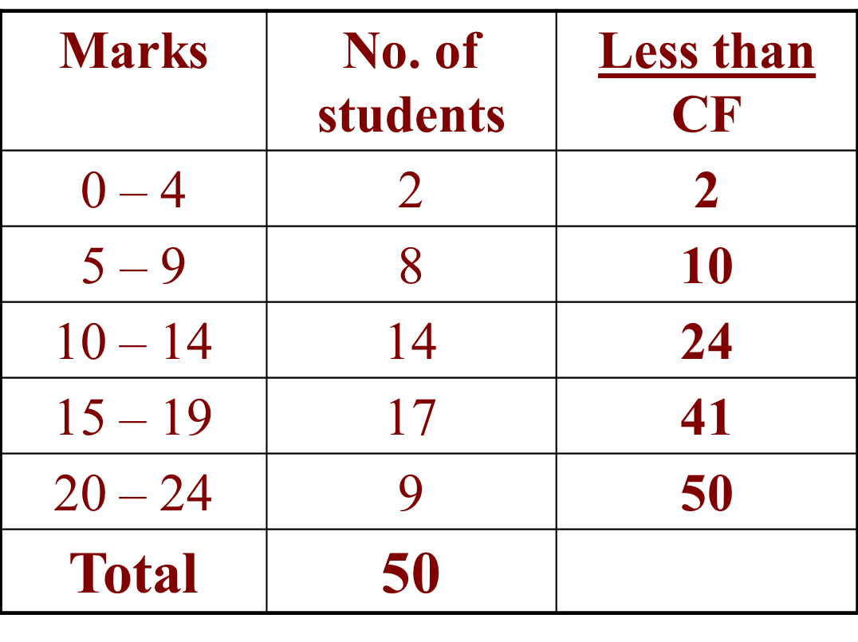
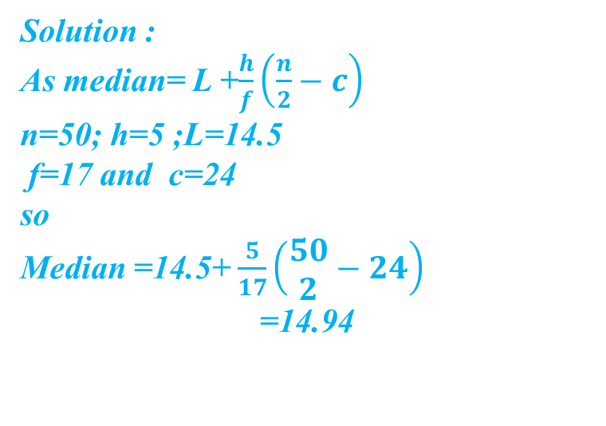
Example of median For Grouped Data

Slide 20
Mode
The MODE, denoted Mo, is the value which occurs most frequently in a set of measurements or values. In other words, it is the most popular value in a given set.
Croxton and Cowden : defined it as “the mode of a distribution is the value at the point armed with the item tend to most heavily concentrated. It may be regarded as the most typical of a series of value”

Slide 21
Example 2: In a crash test, 11 cars were tested to determine what impact speed was required to obtain minimal bumper damage. Find the mode of the speeds given in miles per hour below. 24, 15, 18, 20, 18, 22, 24, 26, 18, 26, 24
Solution: Ordering the data from least to greatest, we get:
15, 18, 18, 18, 20, 22, 24, 24, 24, 26, 26
Answer: Since both 18 and 24 occur three times, the modes are 18 and 24 miles per hour.

Slide 22
Formula:

Slide 23
Find the modal class and the actual mode of the data set below
Number | Frequency
1 - 3 | 7
4 - 6 | 6
7 - 9 | 4
10 - 12 | 2
13 - 15 | 2
16 - 18 | 8
19 - 21 | 1
22 - 24 | 2
25 - 27 | 3
28 - 30 | 2

Slide 25
Advantages of Mode :
Mode is readily comprehensible and easily calculated
It is the best representative of data
It is not at all affected by extreme value.
The value of mode can also be determined graphically.
It is usually an actual value of an important part of the series.

Slide 26
Disadvantages of Mode :
It is not based on all observations.
It is not capable of further mathematical manipulation.
Mode is affected to a great extent by sampling fluctuations.
Choice of grouping has great influence on the value of mode.

Slide 27
Advantages of Median:
Median can be calculated in all distributions.
Median can be understood even by common people.
Median can be ascertained even with the extreme items.
It can be located graphically
It is most useful dealing with qualitative data

Slide 28
Disadvantages of Median:
It is not based on all the values.
It is not capable of further mathematical treatment.
It is affected fluctuation of sampling.
In case of even no. of values it may not the value from the data.

Slide 29
Properties of mode
It is used when you want to find the value which occurs most often.
It is a quick approximation of the average.
It is an inspection average.
It is the most unreliable among the three measures of central tendency because its value is undefined in some observations.

Slide 30
Properties of Mean
Mean can be calculated for any set of numerical data, so it always exists.
A set of numerical data has one and only one mean.
Mean is the most reliable measure of central tendency since it takes into account every item in the set of data.
It is greatly affected by extreme or deviant values (outliers)
It is used only if the data are interval or ratio.

Slide 31
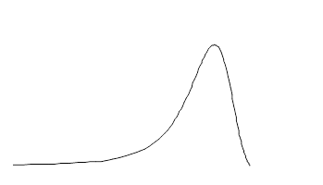
Relations Between the Measures of Central Tendency
In symmetrical distributions, the median and mean are equal
For normal distributions, mean = median = mode
In positively skewed distributions, the mean is greater than the median
In negatively skewed distributions, the mean is smaller than the median

Slide 32
Conclusion
A measure of central tendency is a measure that tells us where the middle of a bunch of data lies.
Mean is the most common measure of central tendency. It is simply the sum of the numbers divided by the number of numbers in a set of data. This is also known as average.
Median is the number present in the middle when the numbers in a set of data are arranged in ascending or descending order. If the number of numbers in a data set is even, then the median is the mean of the two middle numbers.
Mode is the value that occurs most frequently in a set of data.

Slide 33
Thank You

